Slide 1
Progress report of high sensitivity e-skin
Goal: realize the real time reflection of location and related force parameters.
Properties:
High sensitivity
Reflect location parameters
Detect real force parameters

Slide 2
Outline
The previous work(include video show)
The current work(LED function design)
The future appearance(show)

Slide 3
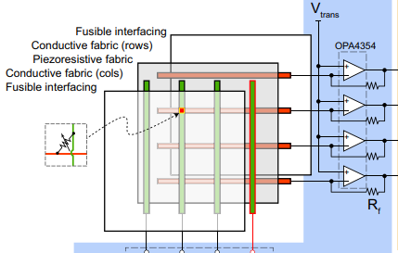
The whole design
ESP32-C6
ADC
ADC
PC
ADC
ADC
GPIO
GPIO
GPIO
GPIO
ADC: analog to digital convert
GPIO: general purpose Input and Output

Slide 4
Working Principle
A column-parallel readout strategy:
A column-parallel readout strategy was implemented to scan the array with minimal discrete components. The circuitry was controlled by a FPGA to take advantage of its parallel processing capabilities.
This working principle is similar with keyboard working principle
Fig1. keyboard

Slide 5

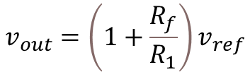


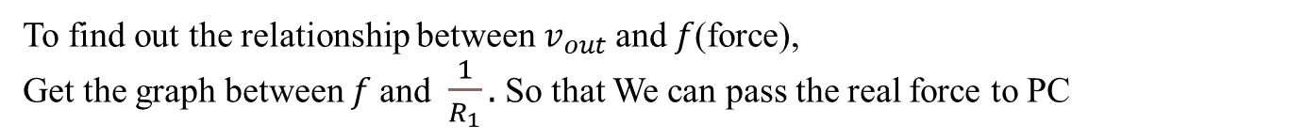
Analysis
$$v_{ref}$$
$$R_{1}$$
-
$$v_{out}$$
+
$$R_{f}$$
Simplify one unit only for better analysis
$$\frac{0−v_{ref}}{R_{1}}=\frac{v_{ref}−v_{out}}{R_{f}}$$
$$⇒$$
$$v_{out}=\left(1+\frac{R_{f}}{R_{1}}\right)v_{ref}$$
$$\left(1\right)$$
To find out the relationship between $v_{out}$and $f\text{(}\text{force}\text{)}$,
Get the graph between $f$and $\frac{1}{R_{1}}.$So that We can pass the real force to PC

Slide 6
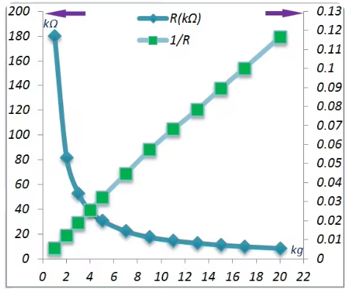





Obtain the function graph between 1/R and force of M0808M
The function of force and 1/R is almost linear function
$$\frac{1}{R_{1}}=0.0075×f$$
$$\left(2\right)$$
Combined (1) and (2),
Given $v_{ref}$ = 1v and $R_{f}$ = 68k
$$v_{out}=0.51⋅f+1$$
$$\left(3\right)$$
$$f=1.96⋅\left(ν_{out}−1\right)$$
$$\left(4\right)$$

Slide 7
Realization steps
Hardware design
- Test and record the 1/R and it’s force relationship function graph.
- Make sure the parameters of amplifier unit, according to the microcomputer ADC.
- Assemble these hardware.
2. Software design
- Testing program: test one column readout array.
- Converting program: converting readout input to it’s real force parameter.
- Final program: test these sensor matrix adding the switching function.

Slide 8
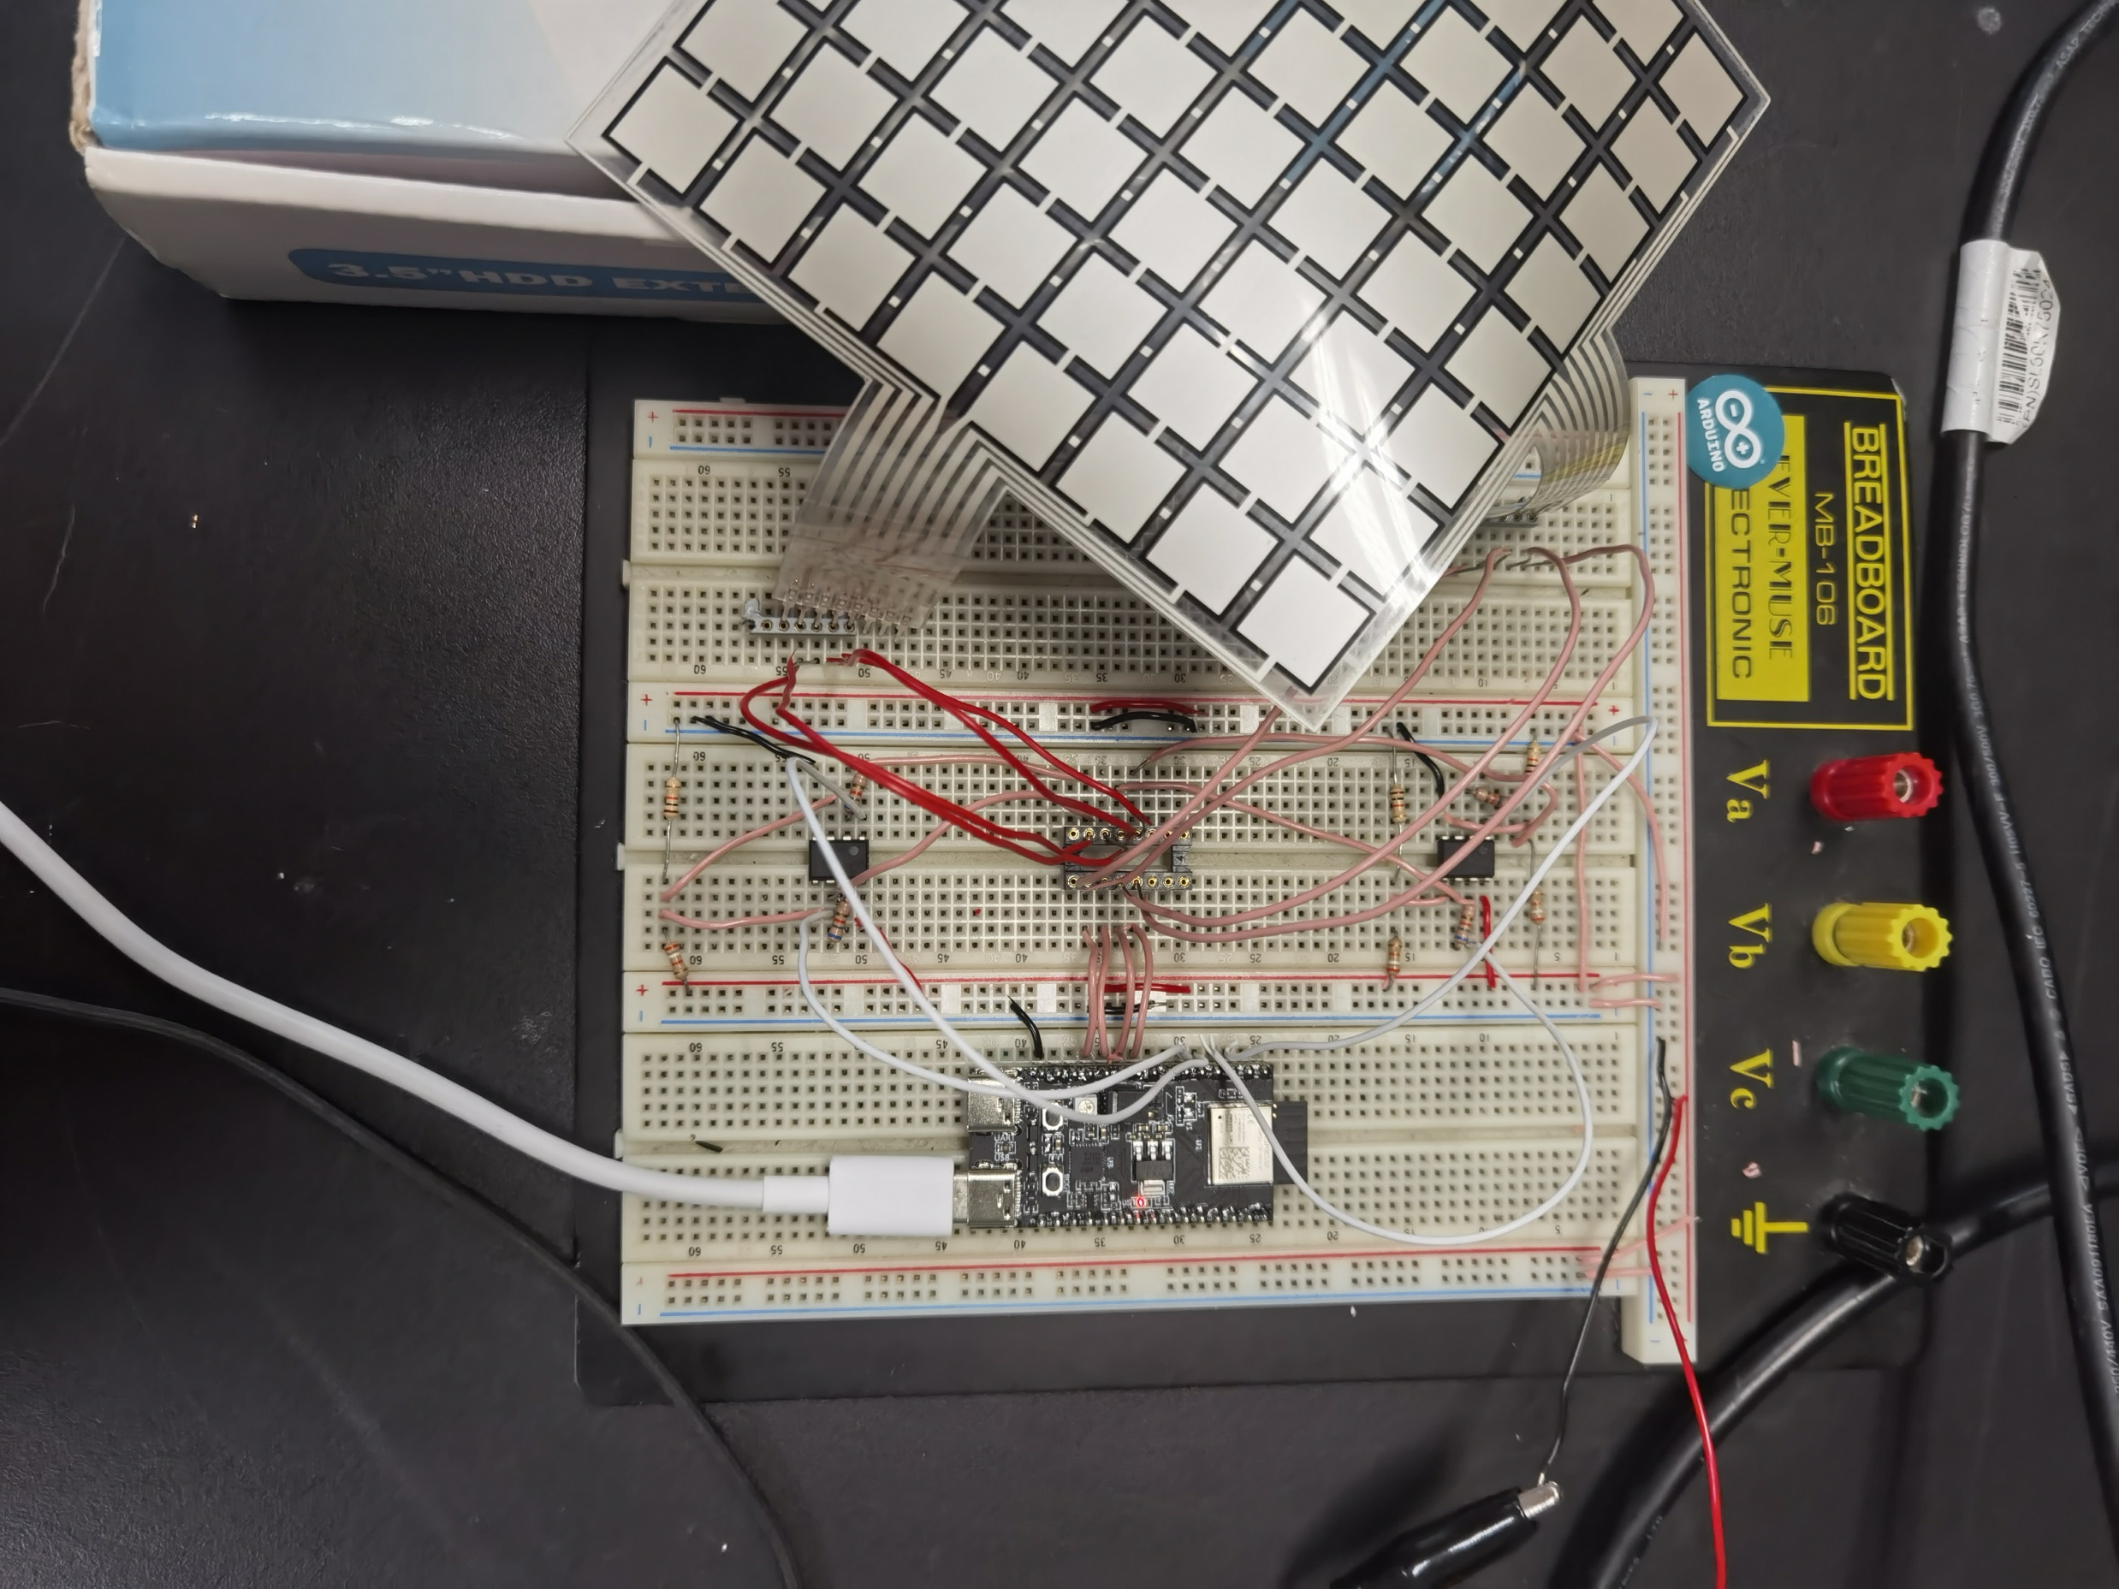
Assembly result
Material:
Microcomputer: ESP32-C6-DevKitM-1
Amplifier units: LM386
Sensor array: M0808M
IDE environment: Arduino IDE
Multi-resistance and multi-line

Slide 9
Start
Software design
Set up the invoking column
FPGA Environment: Arduino IDE
Read each row
read all column?
No
Yes
Convert to force and show to screen
Fg. Flow chart

Slide 10
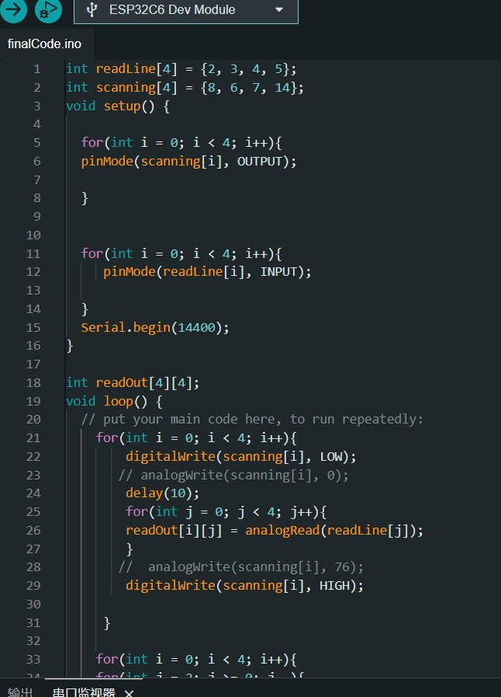
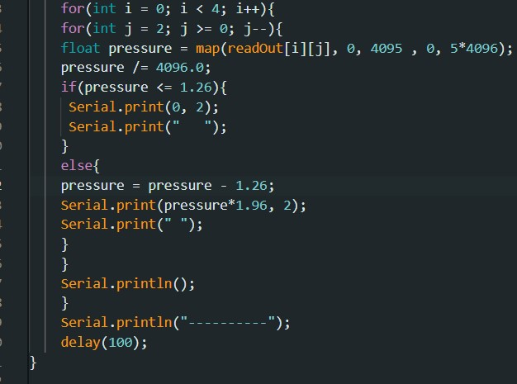
Program Code

Slide 11
Show time
Video link: https://youtu.be/6qERZ66b7y0?si=hPQI47Mdra9JgT9a

Slide 12
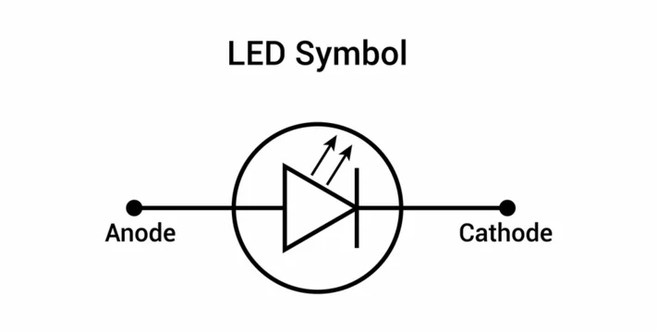
Current work
Add a LED function, which can detect the force of the desired/special location and then light the LED. So that, we can realize the teaching nerve block procedures, according to the requests of Prof. Alonso.
ESP32-C6
ADC
ADC
PC
ADC
ADC
GPIO
GPIO
GPIO
GPIO
GPIO
GPIO
GPIO

Slide 13
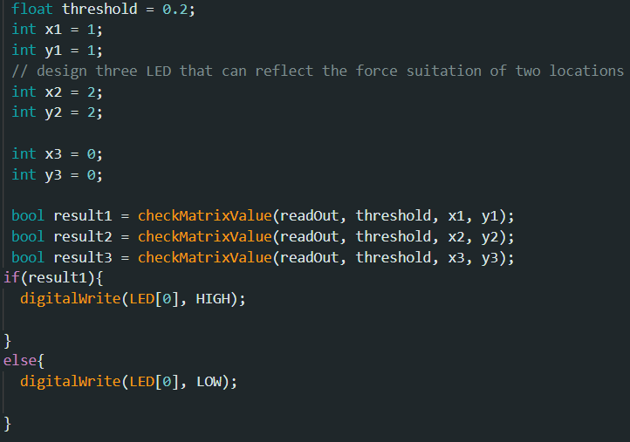
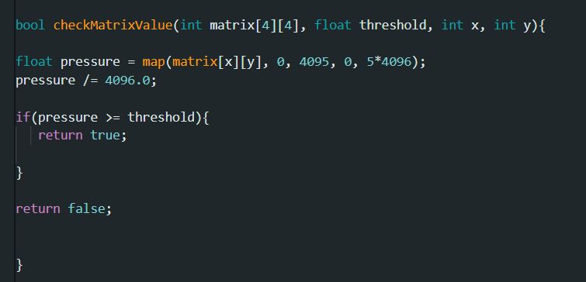
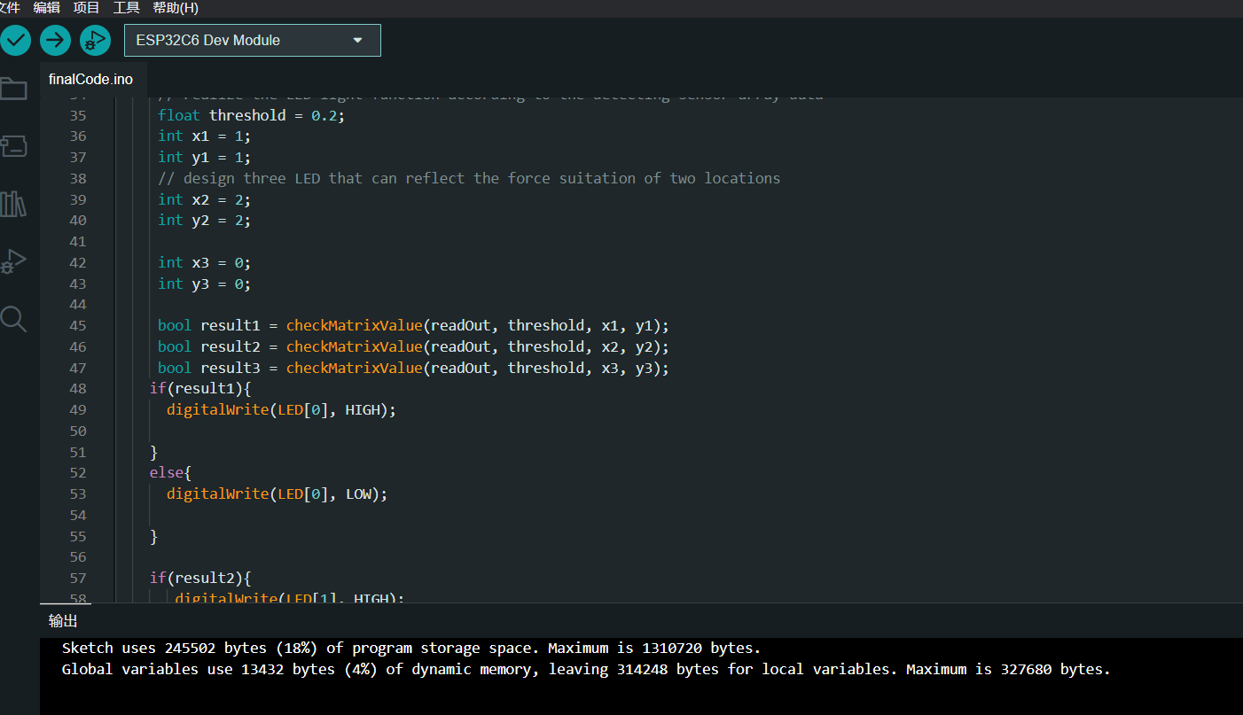
Current outcome
1. Function code design
2. Running Program on ESP32 successfully

Slide 14
Next task
1. Running on the real e-skin, using the code
2. Take an video and show the whole process:
when e-skin detect the desired force of specific location, lighting the LED. When there is no force, the LED light off.

